Slide 1
Software Engineering and Architecture
Pattern Catalog: Builder

Slide 2
Problem
Consider your favorite
Text editor, word processor, spreadsheet, drawing tool
They allow editing a complex data structure representing a document, spreadsheet, etc.

Slide 3
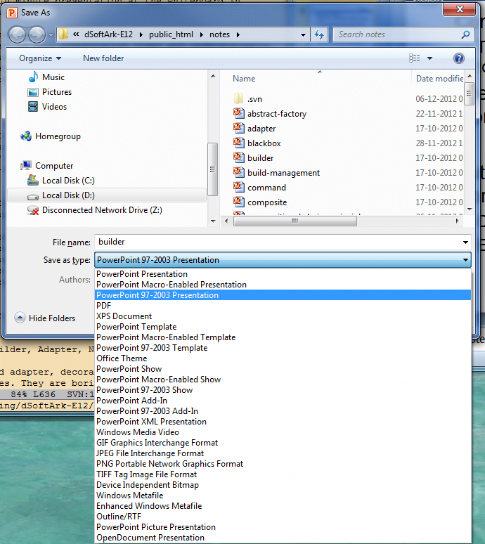
Problem
But they also need to save it to a persistent store, typically a hard disk.
Converting internal data structure to external format
Ex: Binary encoding, XML, HTML, RTF, PDF, …

Slide 4
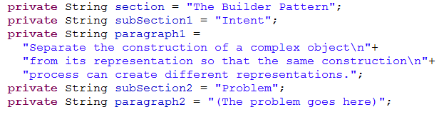
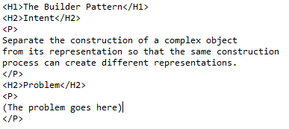
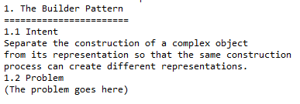
Example
A document consists of
Sections, subsections
paragraphs
We like to output in formats:
HTML
Or ASCII

Slide 5
3-1-2
A classic variability problem

Slide 6
Dynamics
Create the builder
User chose ‘html’ or ‘ascii’
The common part is the director that knows the structure and iterates over all its parts.
The builder handles building each part for the particular output format
Output data structure is known to the client

Slide 7
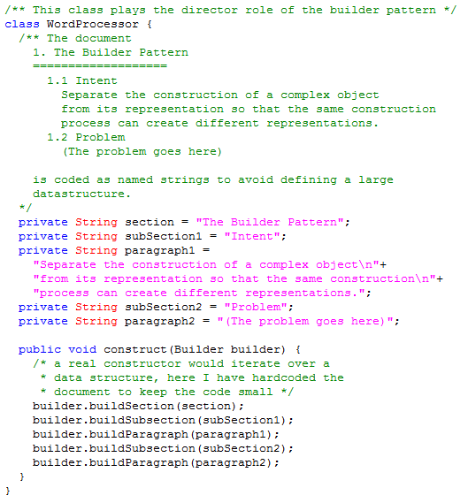
A Fake Object WordProcessor
Note: Also plays the Director role!
(Quite often the case)
A real ‘construct()’ would iterate the document structure! ☺

Slide 8
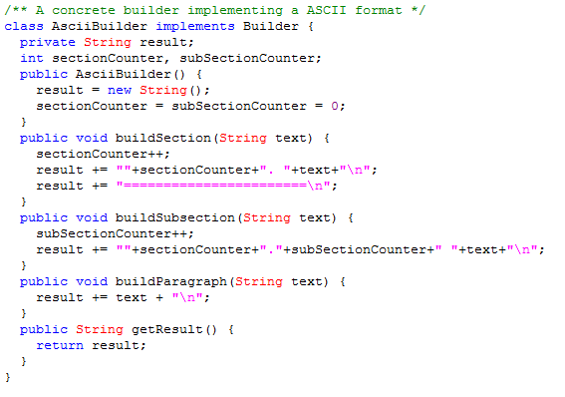
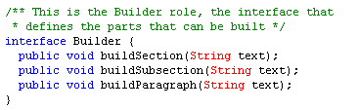
Builder part

Slide 9
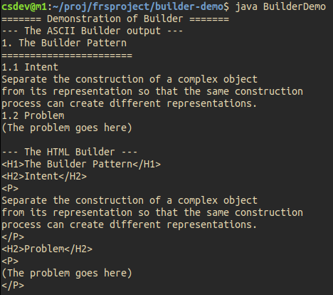
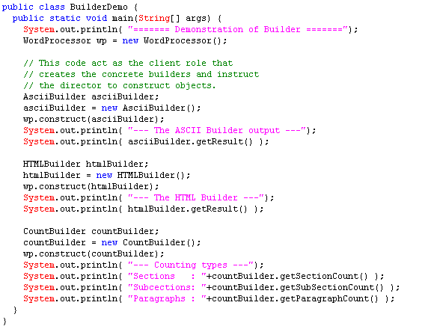
Demo Code

Slide 10
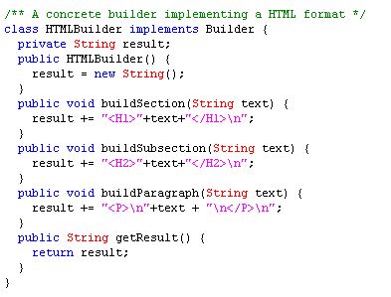
Builder part

Slide 11
Demo Code

Slide 12
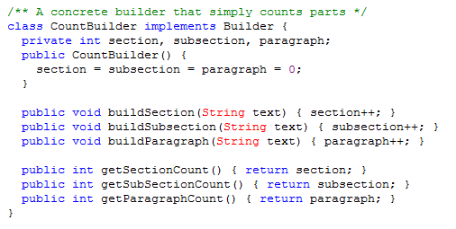
Builder part

Slide 13

Demo Code

Slide 14
Exercise
Why is there no getResult method defined in the interface???

Slide 15
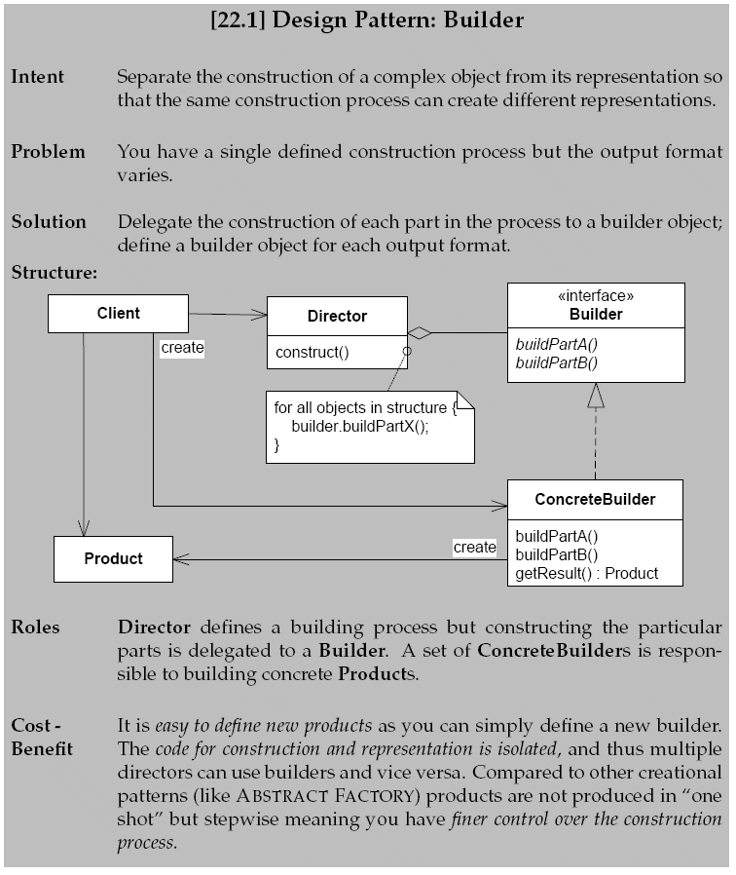

Slide 16
Aspects
Benefits are
Fine grained control over the building process
Compare to Abstract Factory
Construction process and part construction decoupled
Change by addition to support new formats
Many-to-many relation between directors and builders
Reuse the builders in other directors…
Liabilities
Client must know the product of the builder as well as the concrete builder types

